Slide 1
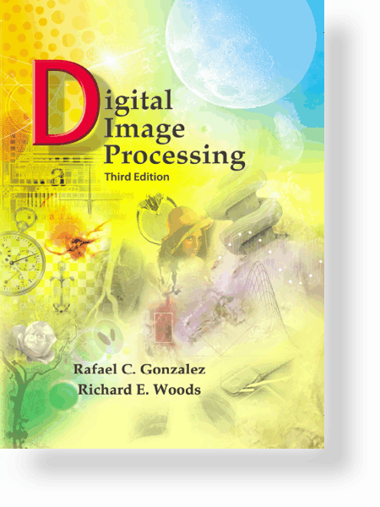
Digital Image Processing, 3rd ed.
Gonzalez & Woods
www.ImageProcessingPlace.com
Chapter 1
Introduction
MAT 262: Bildebehandling/Image processing.
MNF 262: Grunnkurs i bildebehandling og visualisering/Introduction to image processing and visualization.
Lecturer: Erik A. Hanson
Lectures: Mon 12:15-14:00 (640)
Wed 10:15-12:00 (640)
Studentportalen: Check always the course page for announcements exercises and more
BBG/Vis seminars
© 1992–2008 R. C. Gonzalez & R. E. Woods

Slide 2
Digital Image Processing, 3rd ed.
Gonzalez & Woods
www.ImageProcessingPlace.com
Chapter 1
Introduction
Book: Digital image processing, 3rd ed.,by R.C. Gonzalez and R.E. Woods
MAT262: Chapters 1,2,3,4,5,6,7,10 + extra material
MNF262: same as MAT262 except the Fourier/Wavelets and extra material. The first part of the course is in common.
----------------------------------------------------------------------
Chapter 1: Introduction
Chapter 2: Digital Image Fundaments
Chapter 3: Intensity Transformations and Spatial Filtering
Chapter 5: Image restoration and reconstruction (spatial domain only)
Chapter 6: Color Image processing
Chapter 10: Image segmentation (spatial domain only)
(end of curriculum MNF262)
-------
(additional curriculumfor MAT262)
Chapter 4: Filtering in the frequency domain
Chapter 5: Image restoration and reconstruction (frequency domain)
Chapter 7 Wavelets and multiresolution processing
Chapter 10: Image segmentation (frequency domain)
Rudin-Osher-Fatemi model for noise reduction
Graph methods in image processing
Optimization models for image registrations
Active contour models/level sets for image segmentation
(end of curriculum MAT262)
© 1992–2008 R. C. Gonzalez & R. E. Woods

Slide 3
Digital Image Processing, 3rd ed.
Gonzalez & Woods
www.ImageProcessingPlace.com
Chapter 1
Introduction
Exam format:
Oral examination (about 45 minutes) consisting of:
Short presentation of personal project.
Additional questions.
© 1992–2008 R. C. Gonzalez & R. E. Woods

Slide 4
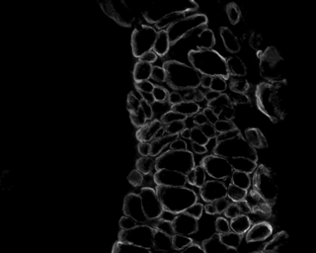
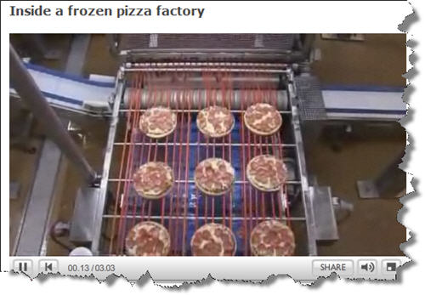
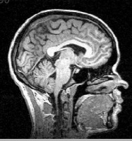
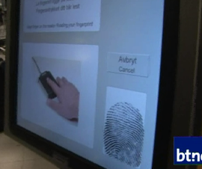
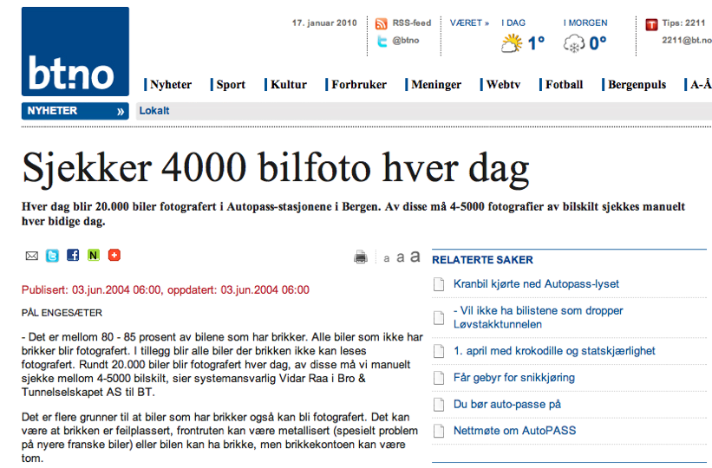
Digital Image Processing, 3rd ed.
Gonzalez & Woods
www.ImageProcessingPlace.com
Chapter 1
Introduction
The need/motivation for image processing:
The enhancement/improvement of pictorial information for:
human interpretation
automatic management (identification, storage, transmission, quantification, ...)
© 1992–2008 R. C. Gonzalez & R. E. Woods

Slide 5
Digital Image Processing, 3rd ed.
Gonzalez & Woods
www.ImageProcessingPlace.com
Chapter 1
Introduction
What is digital image processing?
Processing of an image by means of digital computers.
Image analysis - Image processing - Computer vision
© 1992–2008 R. C. Gonzalez & R. E. Woods

Slide 8
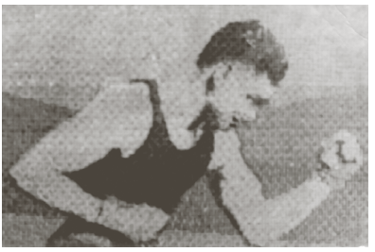
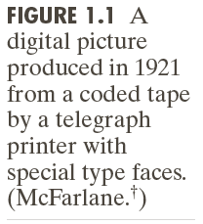
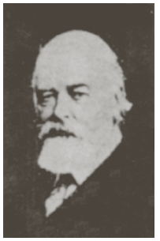
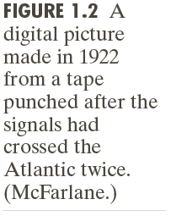
Digital Image Processing, 3rd ed.
Gonzalez & Woods
www.ImageProcessingPlace.com
Chapter 1
Introduction
One of the first application areas of digital images was newspapers industries (cable between London and NY)
Important to reduce transfer time.
Digital computers: 1940
1st computer able to do digital image manipulations: early 1960
© 1992–2008 R. C. Gonzalez & R. E. Woods

Slide 9
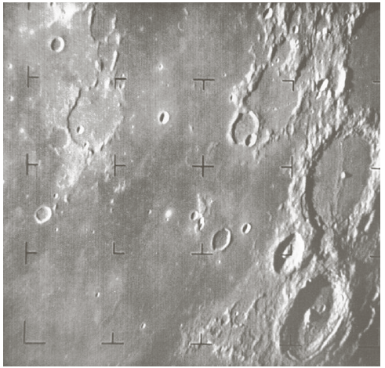
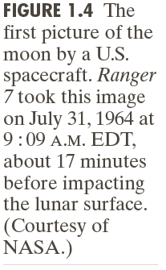
Digital Image Processing, 3rd ed.
Gonzalez & Woods
www.ImageProcessingPlace.com
Chapter 1
Introduction
© 1992–2008 R. C. Gonzalez & R. E. Woods

Slide 10
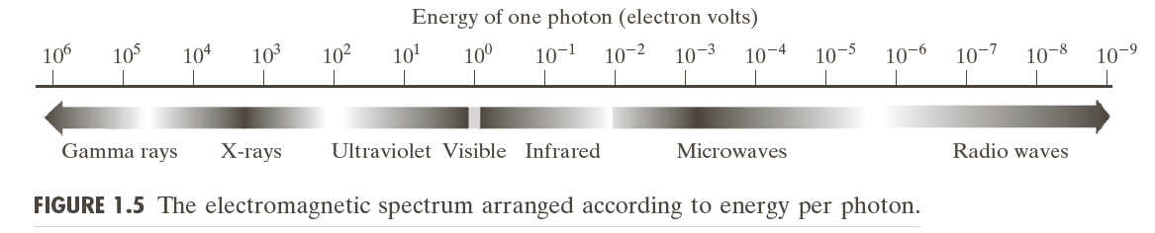
Digital Image Processing, 3rd ed.
Gonzalez & Woods
www.ImageProcessingPlace.com
Chapter 1
Introduction
Principal energy source for images today: electromagnetic energy spectrum.
© 1992–2008 R. C. Gonzalez & R. E. Woods

Slide 11
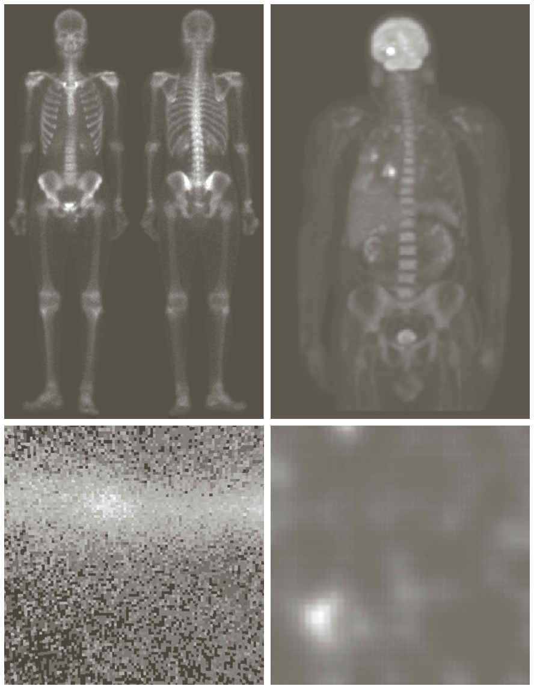
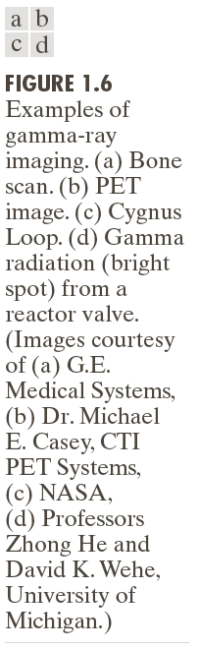
Digital Image Processing, 3rd ed.
Gonzalez & Woods
www.ImageProcessingPlace.com
Chapter 1
Introduction
Gamma rays:
Nuclear medicine
(injection of radioactive tracer)
Astronomical observations
(object generate gamma rays)
© 1992–2008 R. C. Gonzalez & R. E. Woods

Slide 12
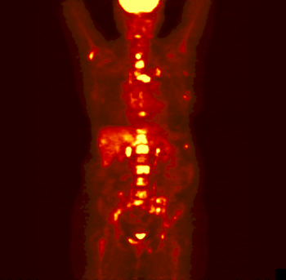
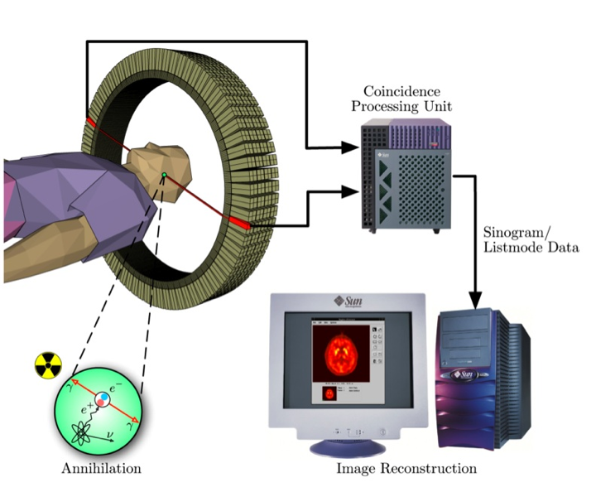
Digital Image Processing, 3rd ed.
Gonzalez & Woods
www.ImageProcessingPlace.com
Chapter 1
Introduction
PET=Positron Emission Tomography
imaging at molecular level
© 1992–2008 R. C. Gonzalez & R. E. Woods

Slide 13
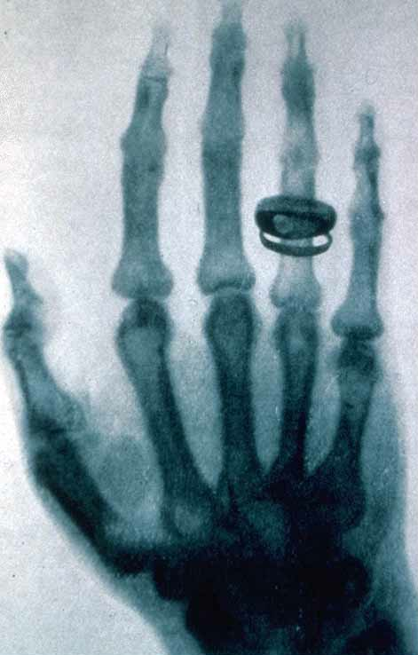
Digital Image Processing, 3rd ed.
Gonzalez & Woods
www.ImageProcessingPlace.com
Chapter 1
Introduction
X-rays (the oldest radiation-type imaging)
-Discovered in 1895 by german physicist William Roentgen
(Nobel prize in physics, 1901)
-used in medicine/industry/astronomy
X-ray tube (catode/anode, controlled by voltage), emitting ray, absorbption by object, rest captured onto a film, digitised.
C.A.T. (Computerized Axial Tomography) uses X-rays.
An x-ray picture (radiograph) taken by Röntgen of Albert von Kölliker's hand at a public lecture on 23 January 1896
© 1992–2008 R. C. Gonzalez & R. E. Woods
Copyright: Radiology Centennial, Inc.

Slide 14
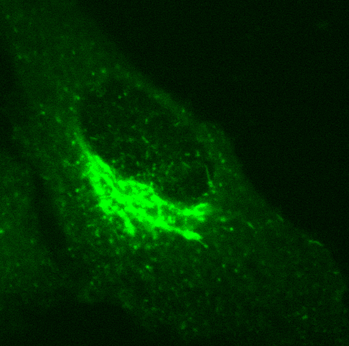
Digital Image Processing, 3rd ed.
Gonzalez & Woods
www.ImageProcessingPlace.com
Chapter 1
Introduction
Ultraviolet band:
microscopy (fluorescence)
the excited electron jumps to another energy level emitting light as a low-energy photon in the red region
lasers
biological imaging
astronomical imaging
industrial inspections
A fluorescent tracer is bind to a molecular target
© 1992–2008 R. C. Gonzalez & R. E. Woods

Slide 15
Digital Image Processing, 3rd ed.
Gonzalez & Woods
www.ImageProcessingPlace.com
Chapter 1
Introduction
Visible and infrared band: the most familiar to us….
light microscopy
infrared: remote sensing, weather prediction,
satellite sensing/ night vision
© 1992–2008 R. C. Gonzalez & R. E. Woods

Slide 16
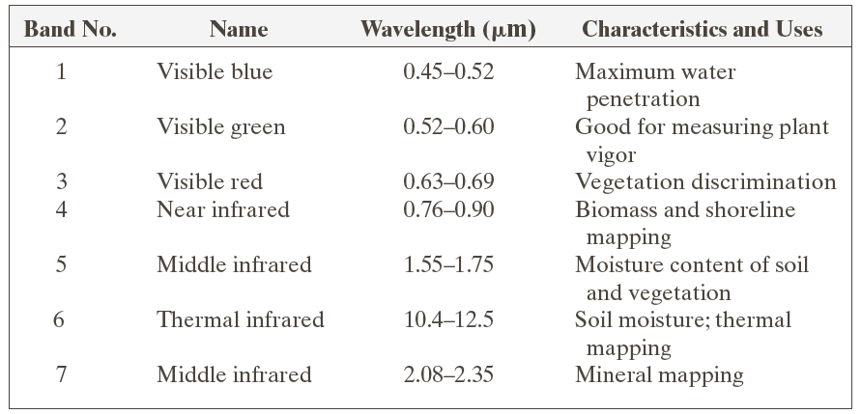
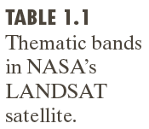
Digital Image Processing, 3rd ed.
Gonzalez & Woods
www.ImageProcessingPlace.com
Chapter 1
Introduction
© 1992–2008 R. C. Gonzalez & R. E. Woods

Slide 17
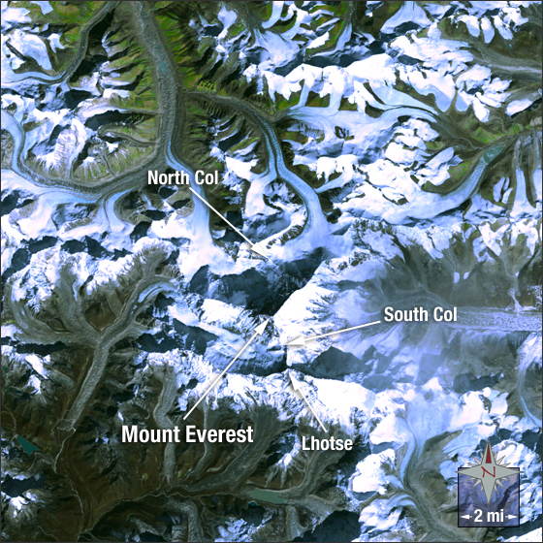
Digital Image Processing, 3rd ed.
Gonzalez & Woods
www.ImageProcessingPlace.com
Chapter 1
Introduction
Mount Everest
Nasa/Landsat
Mount Everest is the highest mountain on Earth, rising 29,029 feet above sea level. It is located on the border of Nepal and Tibet in the Himalayan mountain range. In Tibet the mountain is known as Chomolunga and in Nepal it is called Sagarmatha.
This image of Mount Everest was taken from the International Space Station on November 26, 2003.
In this image you can see Mount Everest covered in white snow with Lhotse, the fourth highest mountain on Earth connected via the South Col — the saddle point between the two peaks. Vegetation appears green and rock and soil appear brown in the image.
This natural color Landsat 5 image was collected on June 11, 2005. It was created using bands 3, 2 and 1. Mount Everest is found on Landsat WRS-2 Path 140 Row 41.
© 1992–2008 R. C. Gonzalez & R. E. Woods

Slide 18
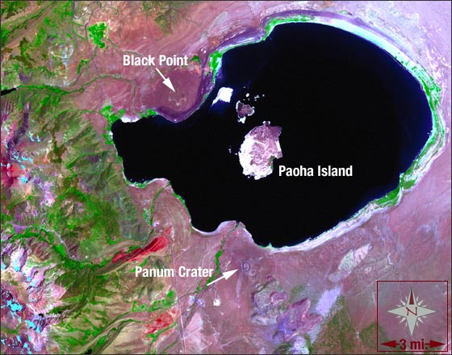
Digital Image Processing, 3rd ed.
Gonzalez & Woods
www.ImageProcessingPlace.com
Chapter 1
Introduction
Mono Lake, California
Nasa/Landsat
This Landsat 7 image of Mono Lake was acquired on July 27, 2000. This image is a false-color composite made from the mid-infrared, near-infrared, and green spectral channels of the Landsat 7 ETM+ sensor – it also includes the panchromatic 15-meter band for spatial sharpening purposes. In this image, the waters of Mono Lake appear a bluish-black and vegetation appears bright green. You will notice the vegetation to the west of the lake and following the tributaries that enter the lake.
© 1992–2008 R. C. Gonzalez & R. E. Woods

Slide 19
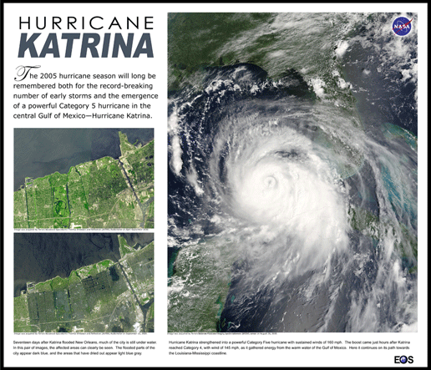
Digital Image Processing, 3rd ed.
Gonzalez & Woods
www.ImageProcessingPlace.com
Chapter 1
Introduction
© 1992–2008 R. C. Gonzalez & R. E. Woods

Slide 20
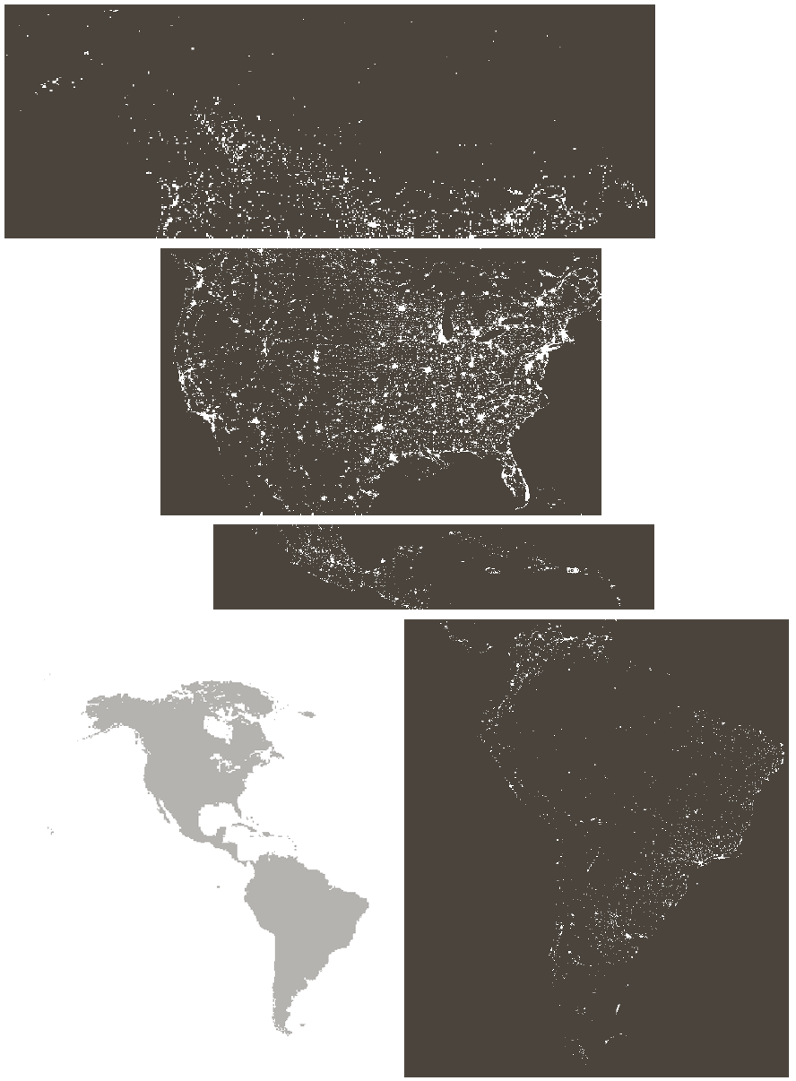
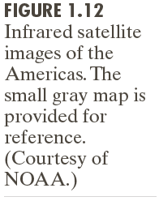
Digital Image Processing, 3rd ed.
Gonzalez & Woods
www.ImageProcessingPlace.com
Chapter 1
Introduction
© 1992–2008 R. C. Gonzalez & R. E. Woods

Slide 21

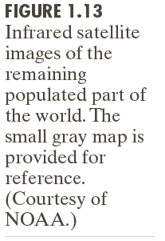
Digital Image Processing, 3rd ed.
Gonzalez & Woods
www.ImageProcessingPlace.com
Chapter 1
Introduction
© 1992–2008 R. C. Gonzalez & R. E. Woods

Slide 22
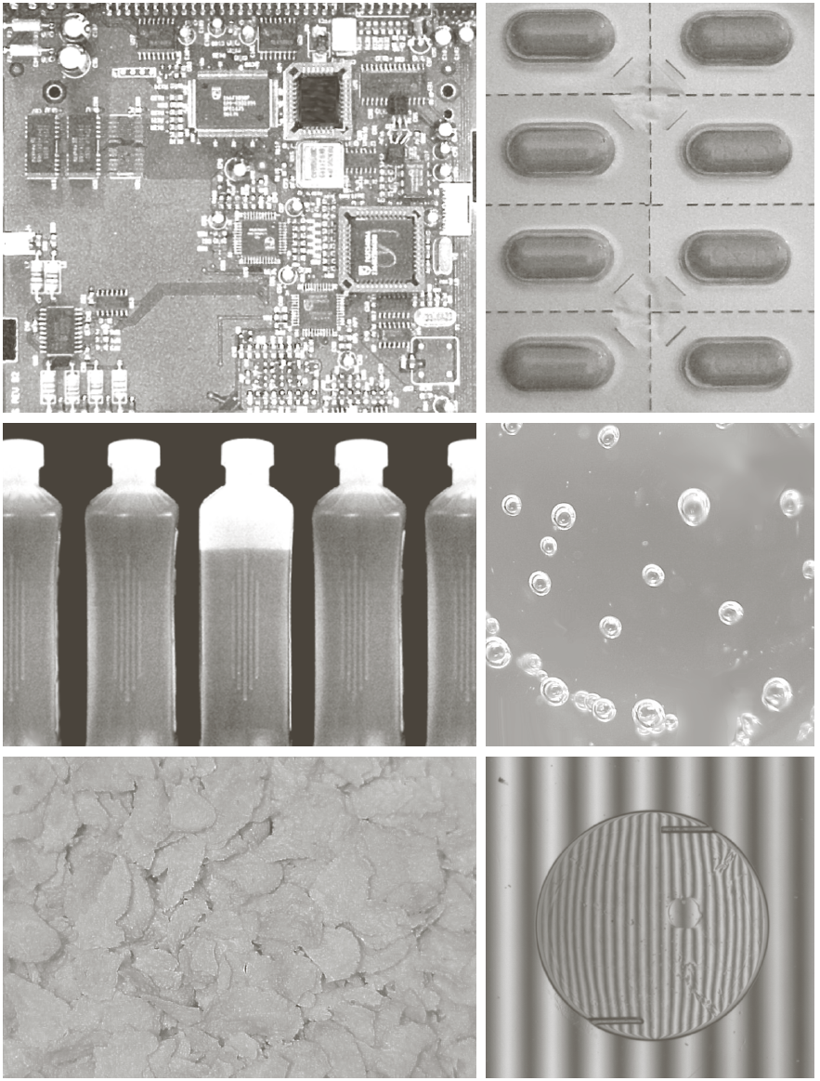
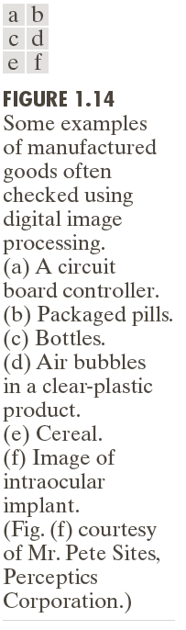
Digital Image Processing, 3rd ed.
Gonzalez & Woods
www.ImageProcessingPlace.com
Chapter 1
Introduction
Visible range:
automated inspection tasks
© 1992–2008 R. C. Gonzalez & R. E. Woods

Slide 23
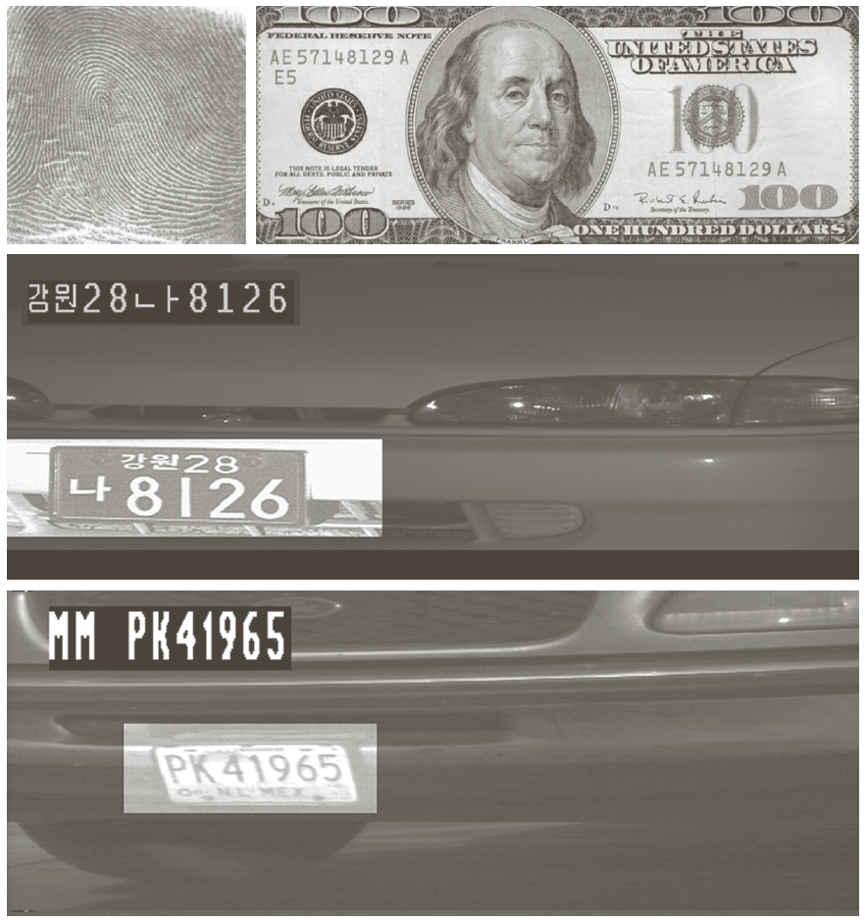
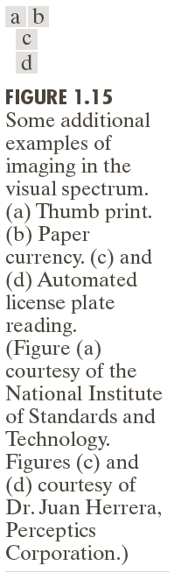
Digital Image Processing, 3rd ed.
Gonzalez & Woods
www.ImageProcessingPlace.com
Chapter 1
Introduction
© 1992–2008 R. C. Gonzalez & R. E. Woods

Slide 24
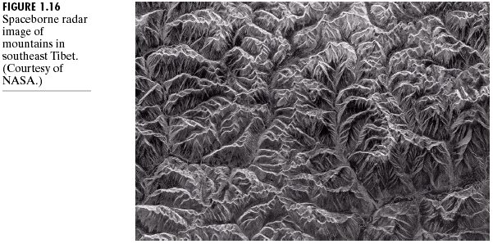
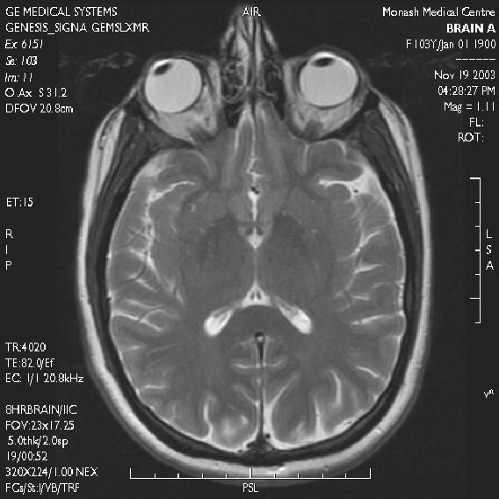
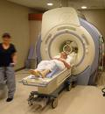
Digital Image Processing, 3rd ed.
Gonzalez & Woods
www.ImageProcessingPlace.com
Chapter 1
Introduction
radio band:
MRI - imaging
(Nobel prizes: Bloch 1952,
… , 2003)
A strong magnet passes radio waves
though short pulses which causes
a response pulse (echo)
© 1992–2008 R. C. Gonzalez & R. E. Woods

Slide 25
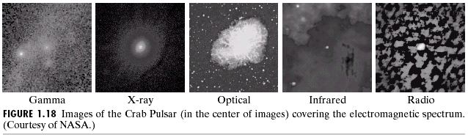
Digital Image Processing, 3rd ed.
Gonzalez & Woods
www.ImageProcessingPlace.com
Chapter 1
Introduction
© 1992–2008 R. C. Gonzalez & R. E. Woods

Slide 26
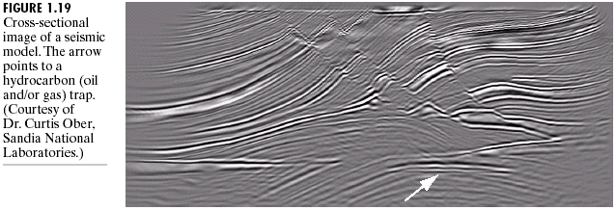
Digital Image Processing, 3rd ed.
Gonzalez & Woods
www.ImageProcessingPlace.com
Chapter 1
Introduction
Other sources of energy
beside electromagnetic waves:
- acoustic waves
(seismic, marine/atmospheric,
sonar/radar, ultrasound)
- electron microscopy
- synthetic images
© 1992–2008 R. C. Gonzalez & R. E. Woods

Slide 28
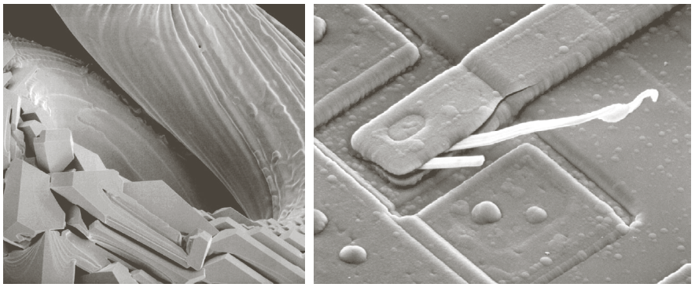
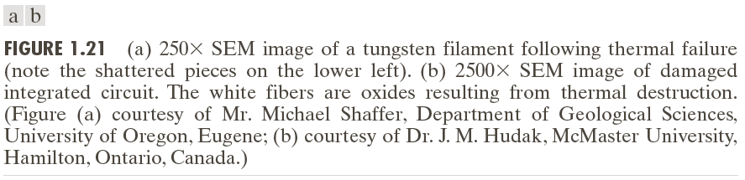
Digital Image Processing, 3rd ed.
Gonzalez & Woods
www.ImageProcessingPlace.com
Chapter 1
Introduction
© 1992–2008 R. C. Gonzalez & R. E. Woods

Slide 29
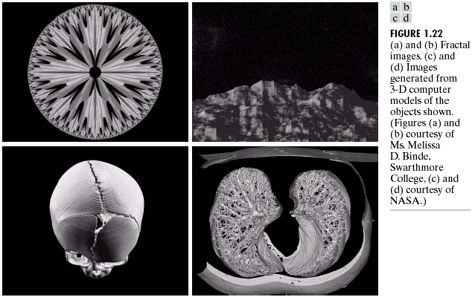
Digital Image Processing, 3rd ed.
Gonzalez & Woods
www.ImageProcessingPlace.com
Chapter 1
Introduction
© 1992–2008 R. C. Gonzalez & R. E. Woods

Slide 30
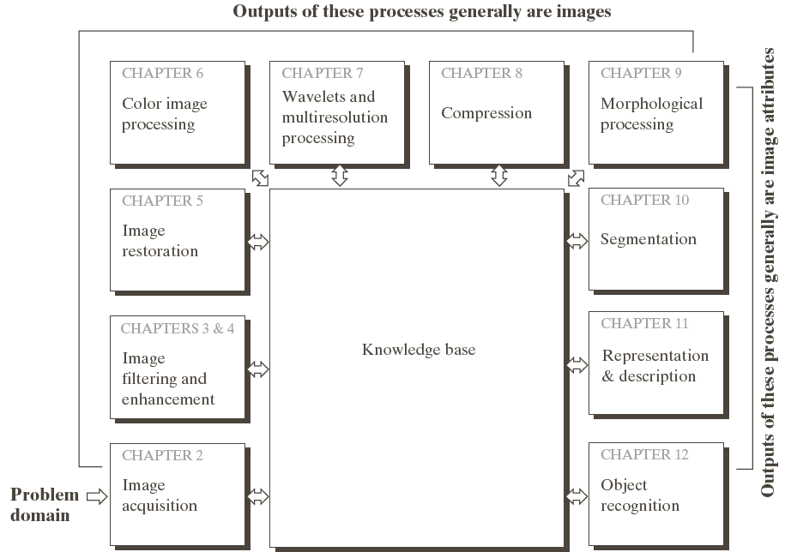
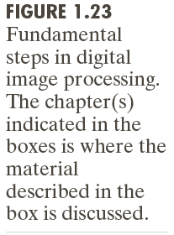
Digital Image Processing, 3rd ed.
Gonzalez & Woods
www.ImageProcessingPlace.com
Chapter 1
Introduction
+ extra stuff
© 1992–2008 R. C. Gonzalez & R. E. Woods

Slide 31
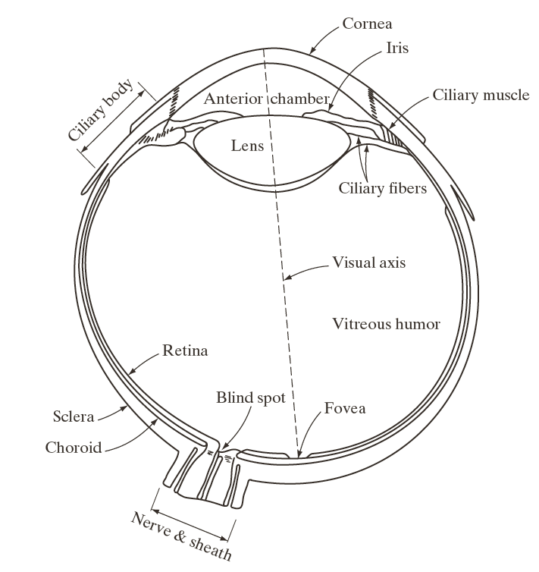
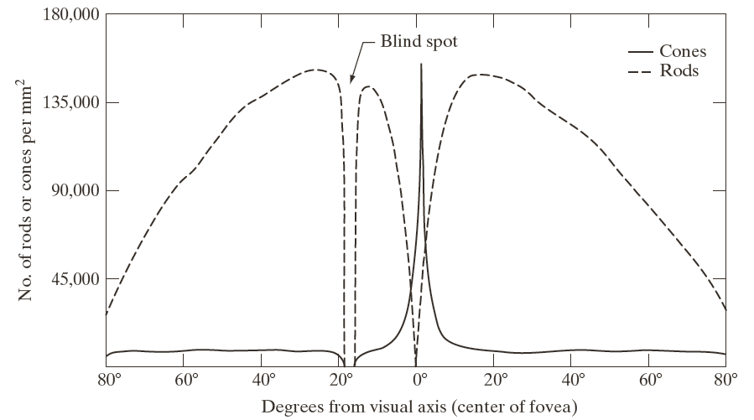
Digital Image Processing, 3rd ed.
Gonzalez & Woods
www.ImageProcessingPlace.com
Chapter 2
Digital Image Fundamentals
Retina: consist of receptors
- cones: highly sensitive to colors. Photopic
or bright-light vision
-rods: give overall picture with reduced detail.
Scotopic or dim-light vision
© 1992–2008 R. C. Gonzalez & R. E. Woods

Slide 32
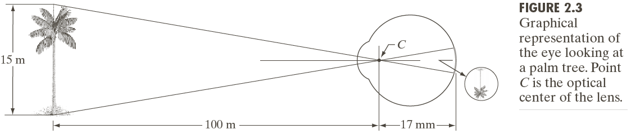
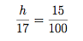
Digital Image Processing, 3rd ed.
Gonzalez & Woods
www.ImageProcessingPlace.com
Chapter 2
Digital Image Fundamentals
This distance varies between 14-17 mm
depending on the lens’ focussing
Classical optical theory:
A ray passes through the centre C of the lens.
The two triangle are proportional:
h is the height of the object on the retina
(note that is located close to the fovea)
© 1992–2008 R. C. Gonzalez & R. E. Woods

Slide 34
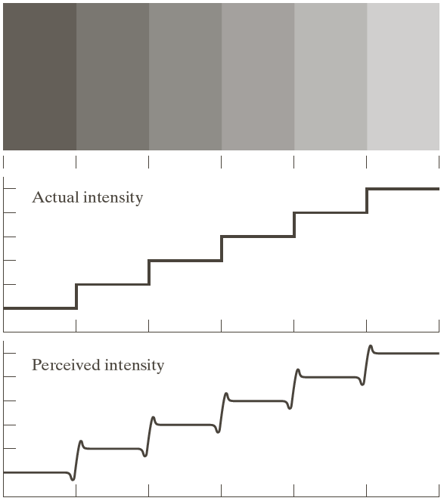
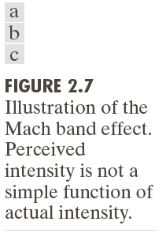
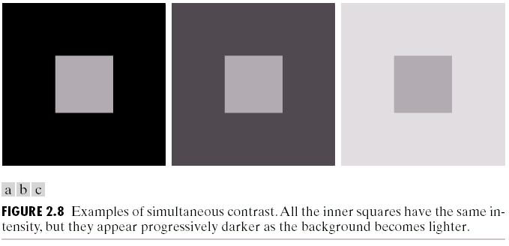
Digital Image Processing, 3rd ed.
Gonzalez & Woods
www.ImageProcessingPlace.com
Chapter 2
Digital Image Fundamentals
Perceived intensity is not a simple function of actual intensity.
- under/overshoot boundary of regions of different intensity (Mach bands)
- A region’s perceived brightness does depend on the background intensity as well (simultaneous contrast)
© 1992–2008 R. C. Gonzalez & R. E. Woods

Slide 35
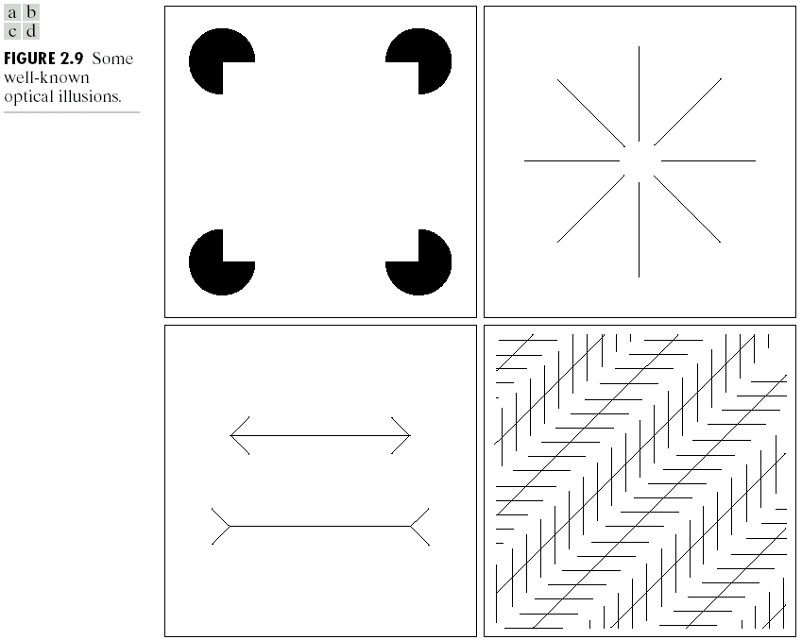
Digital Image Processing, 3rd ed.
Gonzalez & Woods
www.ImageProcessingPlace.com
Chapter 2
Digital Image Fundamentals
Optical illusions and perception:
The eye “fills in” non-existing information or wrongly perceives geometrical properties of objects.
© 1992–2008 R. C. Gonzalez & R. E. Woods

